Slide 1


Slide 2
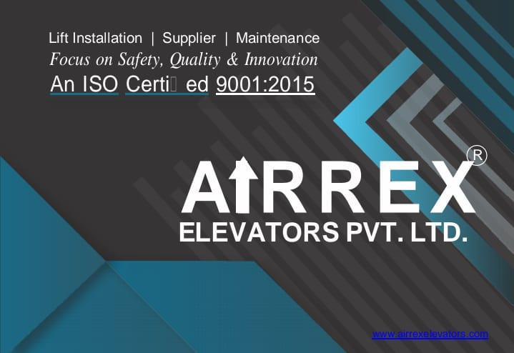

Slide 3
AIRREX ELEVATORS we are known for .
Our best in class after sales services across pan India .
Focused customer safety and delivering non stop comfort rides.
Our least breakdown hours .
Our highly precise German tools making no wear and tear to the products.
Our Trained and skilled Engineers and technicians.
Fair and transparent customer policies .
Our continuous efforts and innovations towards the technology.
Our repeated and satisfied customers.

Slide 4
Why Airrex elevator?
Assurance to the quality of service.
Our backbone ,our specialized team and members.
Not more than 24 hours breakdown in last consecutive 3 years .

Slide 5
RANGE WE ARE SERVING
We are serving a wide range of elevator services across pan india as per the requirements.
Such as residential, industrial, malls, parking lifts ,capsule lifts.

Slide 6
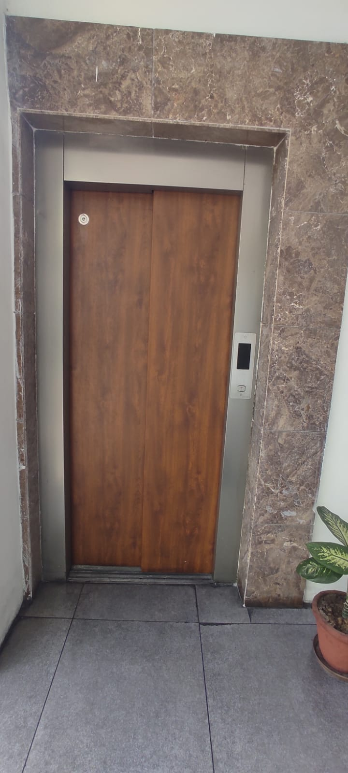
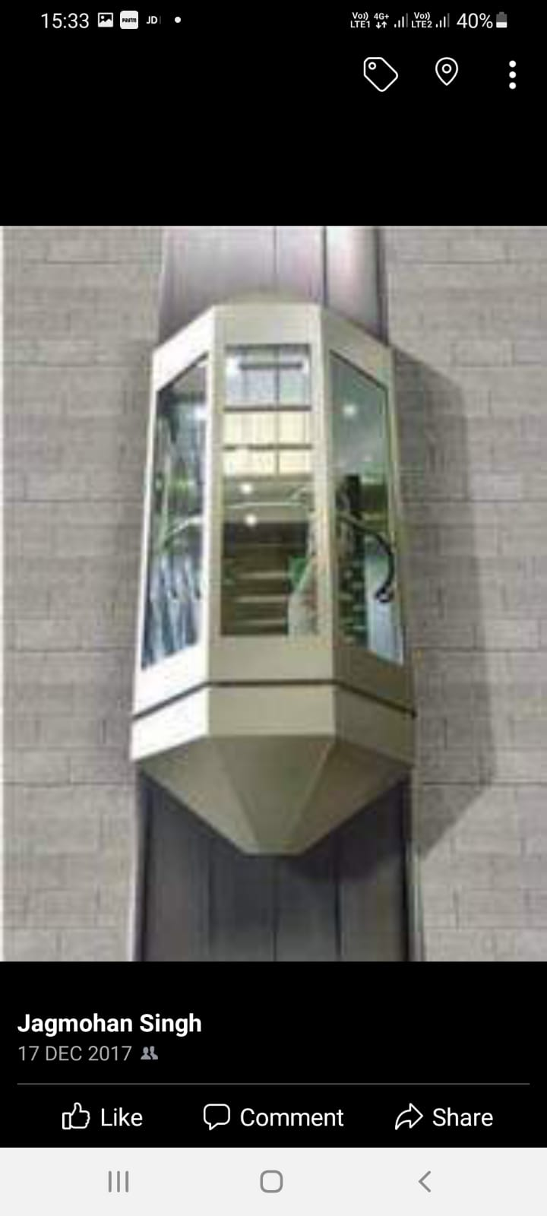
Services at a glance

Slide 7
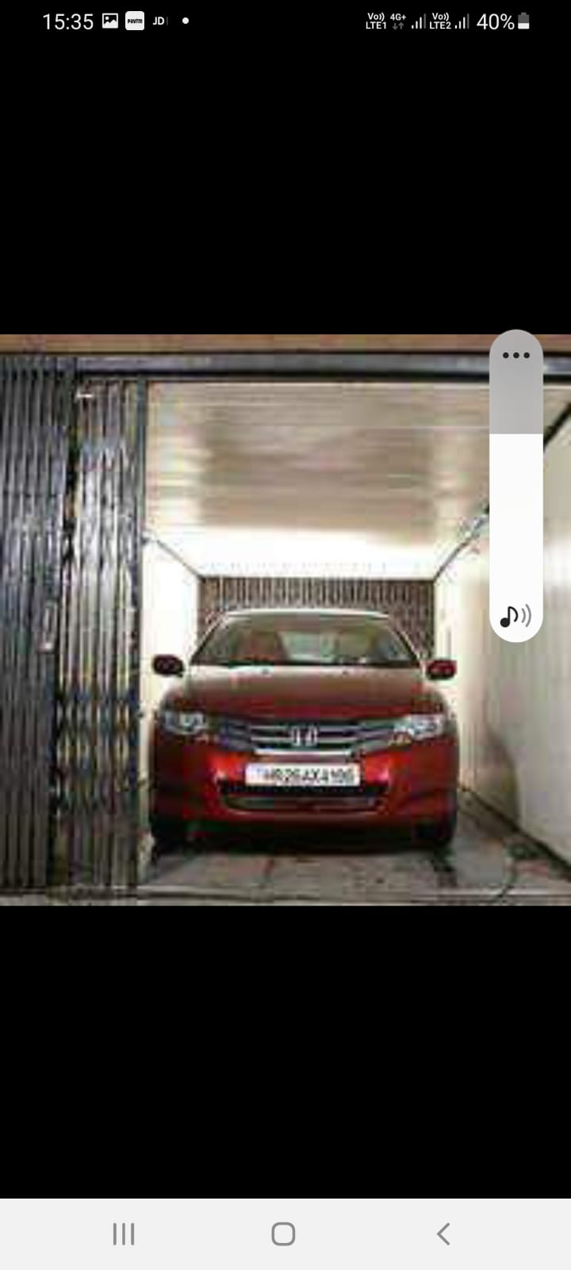
Services at a glance

Slide 8
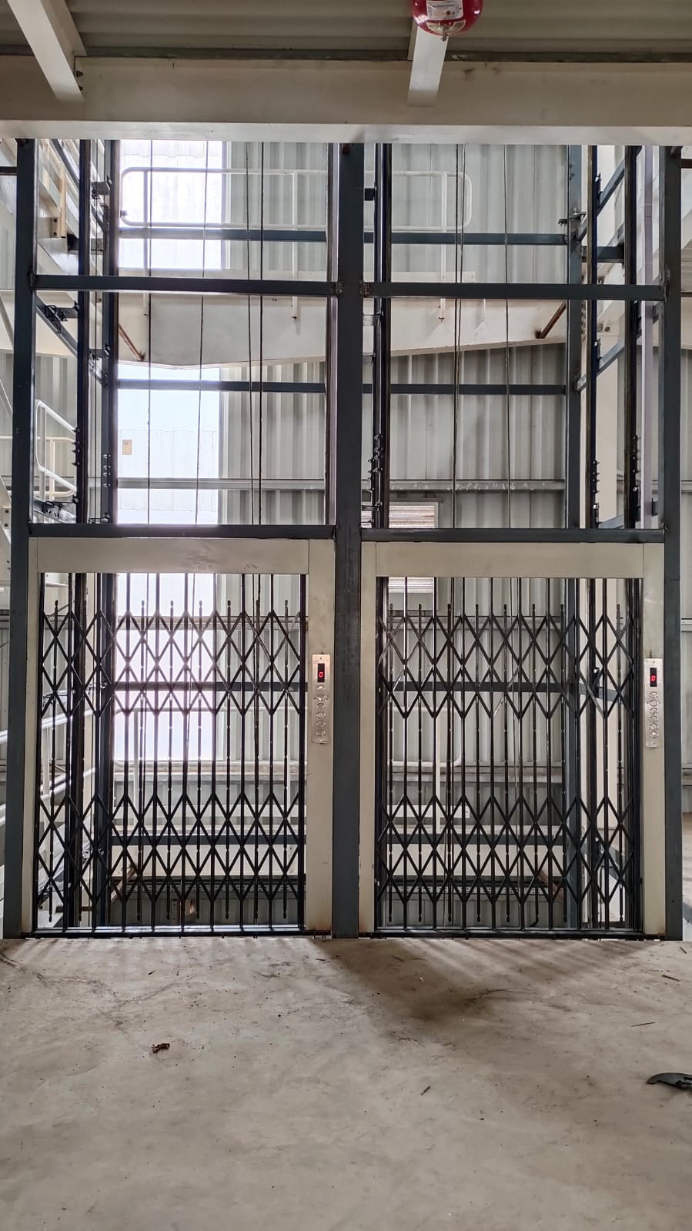
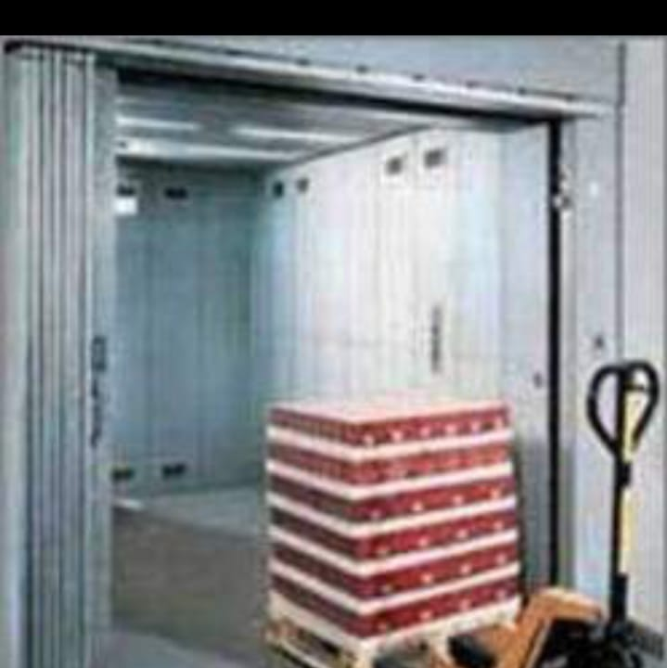
Services at a glance

Slide 9
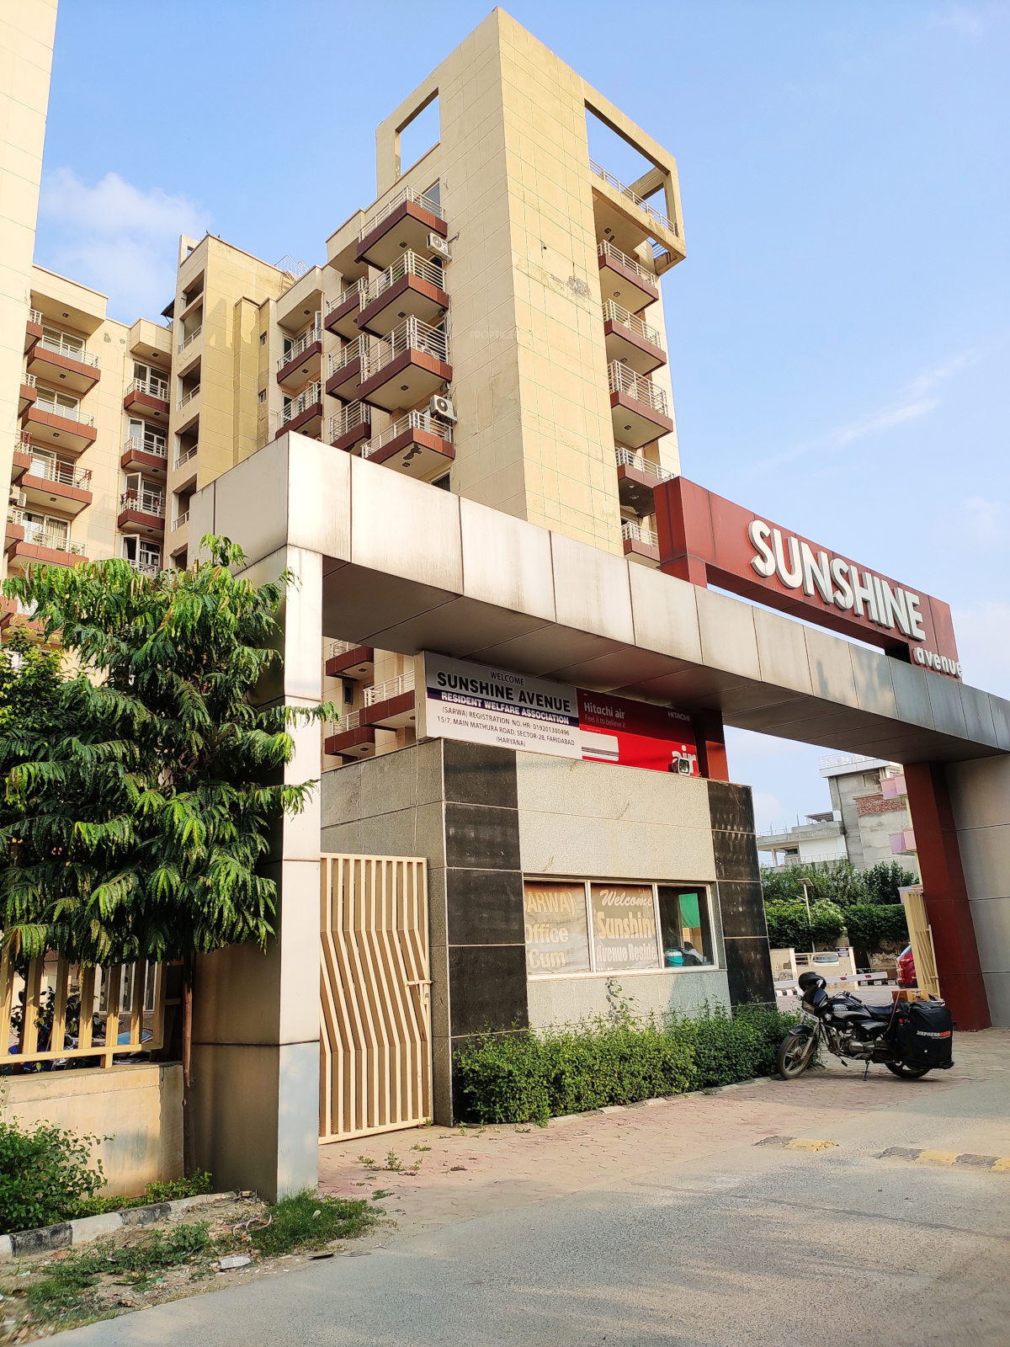
OUR VALUED AND REPEATED CUSTOMERS
Sunshine Avenue

Slide 10
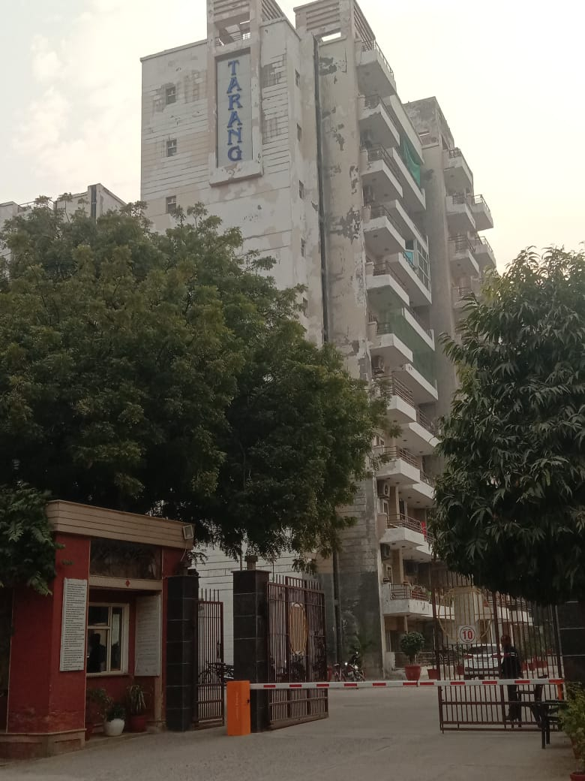
OUR VALUED AND REPEATED CUSTOMERS
Tarang

Slide 11
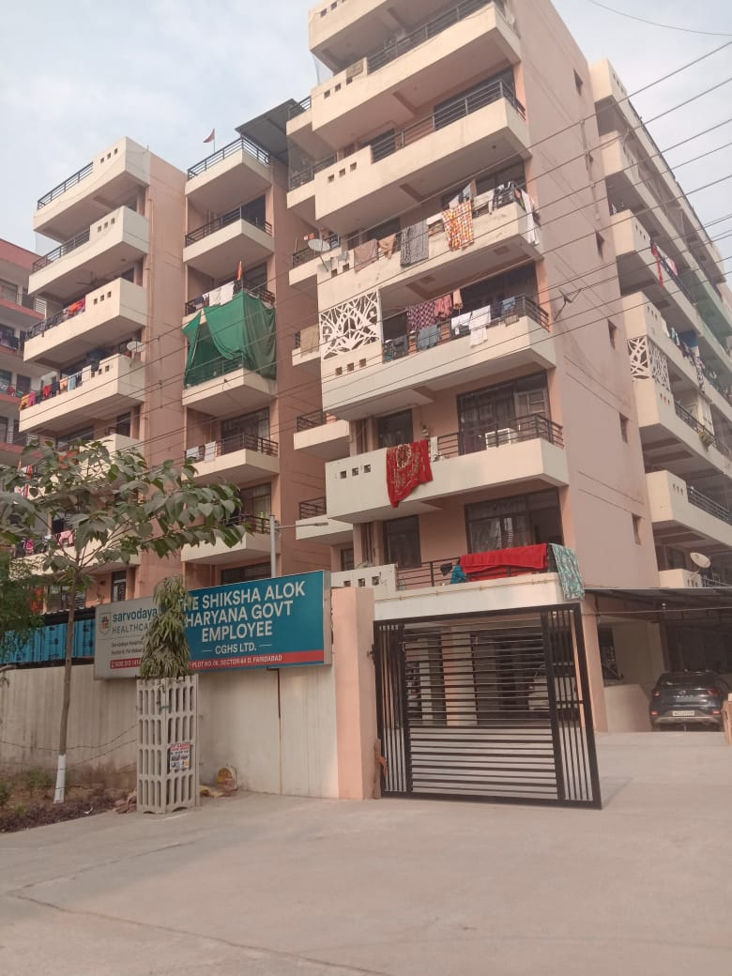
OUR VALUED AND REPEATED CUSTOMERS
Shiksha lok CGHS LTD.

Slide 12

Airrex elevators, a legend in vertical transportation , safely serving more than 8000 families each year at their residence.

Slide 13
Terms and conditions .
Airrex offers service visit (9+3)=12 per year, with 24*7 service and 60 min expose time
During the service period all electrical and mechanical parts will be replaced by Airrex elevators.
AMC doesn’t covers any damage caused by water inlet .
Any short circuit happens due to client main supply, will be taken care by client itself.
Control panel assembly MCB is under Airrex scope and will be changed by us if needed.
AMC doesn’t covers any forcefully done damages such as dent on doors, cabin panel, display etc.
Responsible for any lift accidents.

Slide 14
Thank you

